Slide 1

DEPARTMENT OF COMPUTER SCIENCE AND ENGINEERING
STUDENT E-NOTES
under the guidance of
Raheem Unnisa
(Associate professor)
BY
E.SHIVANI(197R1A05K7)
G.VIDYADHARI(197R1A05L2)
D.SUMANTH(197R1A05K6)

Slide 2
ABSTRACT:
Now-a-days many engineering students are facing the problem with lecture notes.Mainly at the time of examinations student don’t have the right platform to gain the skills .Our website (STUDENT E-NOTES) will provide the lecture notes.Here in this website all the notes are simply understandable with simple definitions,flowcharts and block diagrams.
But in all the websites student should search for the particular topic to gather the information required for the notes.Student cannot get the unit wise topics together.Student has to visit more than one websites to learn (flowcharts,diagrams,definitions).In all the diagrams,definitions etc. are provided at one platform.

Slide 3
EXISTING SYSTEM:
There are many websites (geeks for geeks ,tutorials point , java tutorial) in the present day but none of them provide unit wise topics .In the existing websites the topic are not easily understandable and does not provide the familiar Examples. The student cannot able to find the similar lecture notes that is explained by the Faculty. The existing websites may not provide lecture videos.

Slide 4
DISADVANTAGES:
The system does not have any criteria to check whether the student or teacher is of particular college or not.
Anyone can register on the system and can access the data.

Slide 5
PROPOSED SYSTEM:
Our website (STUDENT E-NOTES) will provide complete notes which provided by the college faculty with examples . If student cannot understand from the notes he/she can go through the hyper link which redirect to the lecture videos . This will be easier to students while preparing for the Examinations.The main purpose of our website is to provide the complete unit wise notes which is sorted in the simplest way which is easily understandable and he/she can get the complete notes at one platform instead of visiting the many websites.To access the website the student have to login for the security purpose and misuse of data. Provides the previous question papers.

Slide 6
ADVANTAGES:
Can get the complete notes in the single platform.
Can go through the lecture videos for easy understanding.
Provides the previous question papers
Provides the unit wise topics.

Slide 7
HARDWARE REQUIREMENTS:
Operating System : Windows 10 or later
Hard Disk : 512 GB
Mouse : Optical mouse
RAM : 4GB

Slide 8
SOFTWARE REQUIREMENTS:
HTML
CSS
Java Script
Bootstrap
XMAP
APACHE SERVER
SUBLIME TEXT EDITOR
MYSQLi

Slide 9
NOVELTY:
Our website (STUDENT E-NOTES) will provide complete notes which provided by the college faculty with examples . If student cannot understand from the notes he/she can go through the hyper link which redirect to the lecture videos . This will be easier to students while preparing for the examinations .The main purpose of our website is to provide the complete unit wise notes which is sorted in the simplest way which is easily understandable and he/she can get the complete notes at one platform instead of visiting the many websites .To access the website the student have to login for the security purpose and misuse of data. Provides the previous question papers.

Slide 10
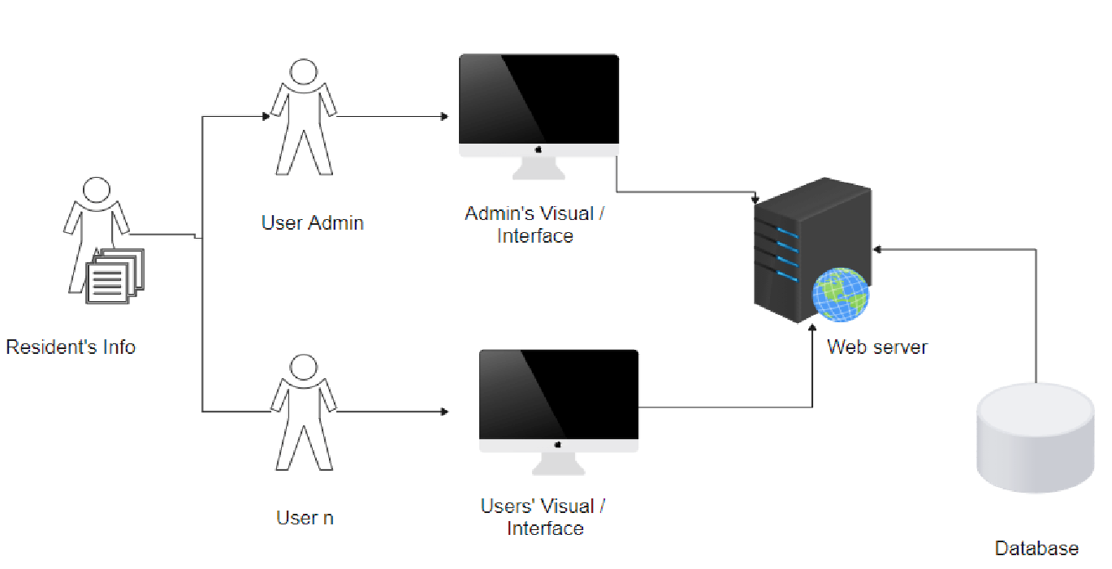
ARCHITECTURE
.

Slide 11
MODULE SPECIFICATIONS:
Student:Students register on the website and login to access the notes uploaded by teachers and view them or download it.
Teacher:The teacher has to first register on the website and then login to upload the note. Teacher can even delete the notes by logging in.
Notes:Notes can be uploaded and deleted by teacher and student. It can be downloaded by every student and teacher.
Admin:The notes are managed by admin. He has rights to approve or disapprove the notes uploaded by particular user.

Slide 12
UML DIAGRAMS
A UML diagram is a diagram with the purpose of visually representing a system along with its main actors, roles, actions, artifacts or classes, in order to better understand, alter, maintain, or document information about the system.
The following are the UML diagrams of our project:
Class Diagram
Use Case Diagram
Data Flow Diagram

Slide 13
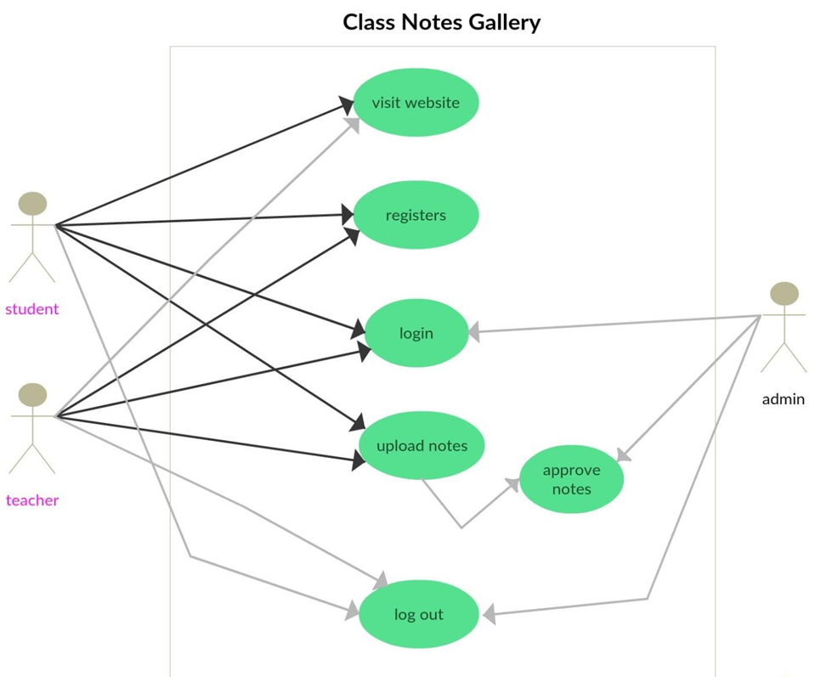
Use Case Diagram

Slide 14
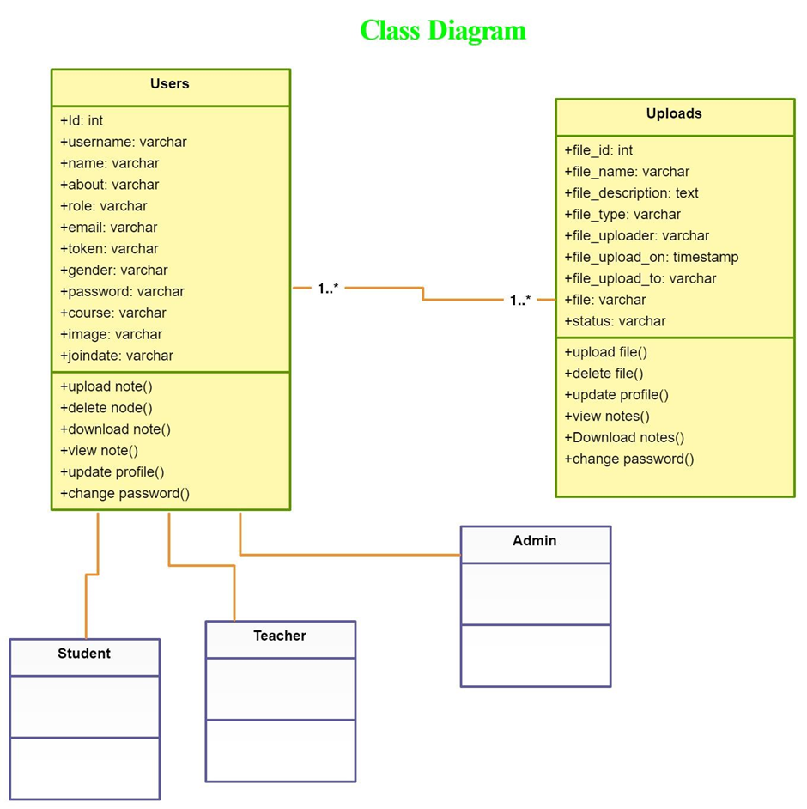
Class Diagram

Slide 15
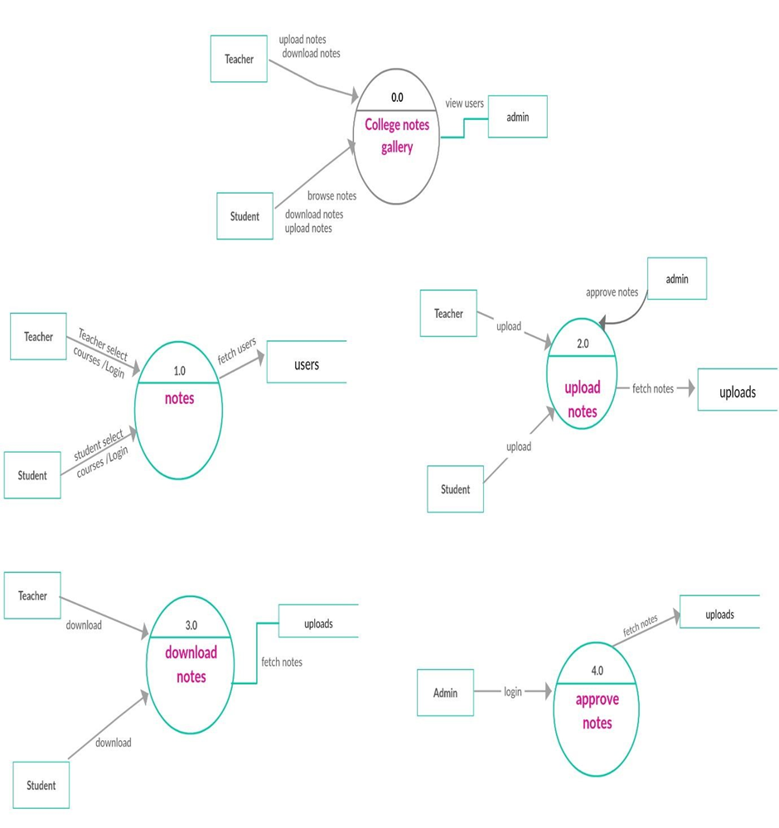
Activity Diagram

Slide 16
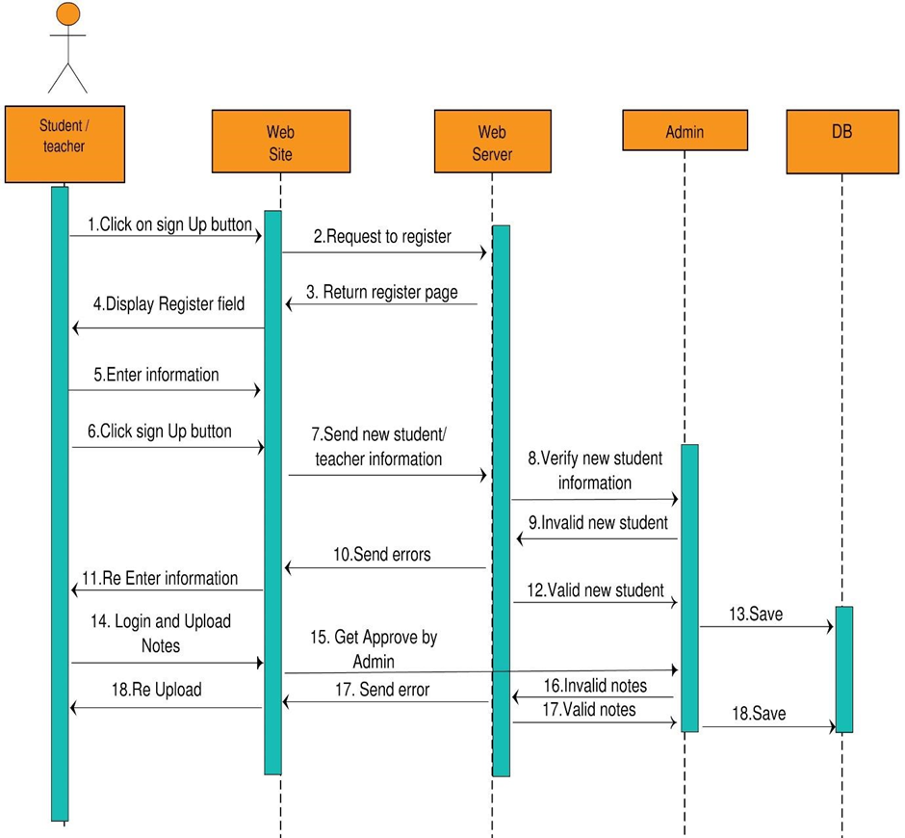
Sequence Diagram

Slide 17
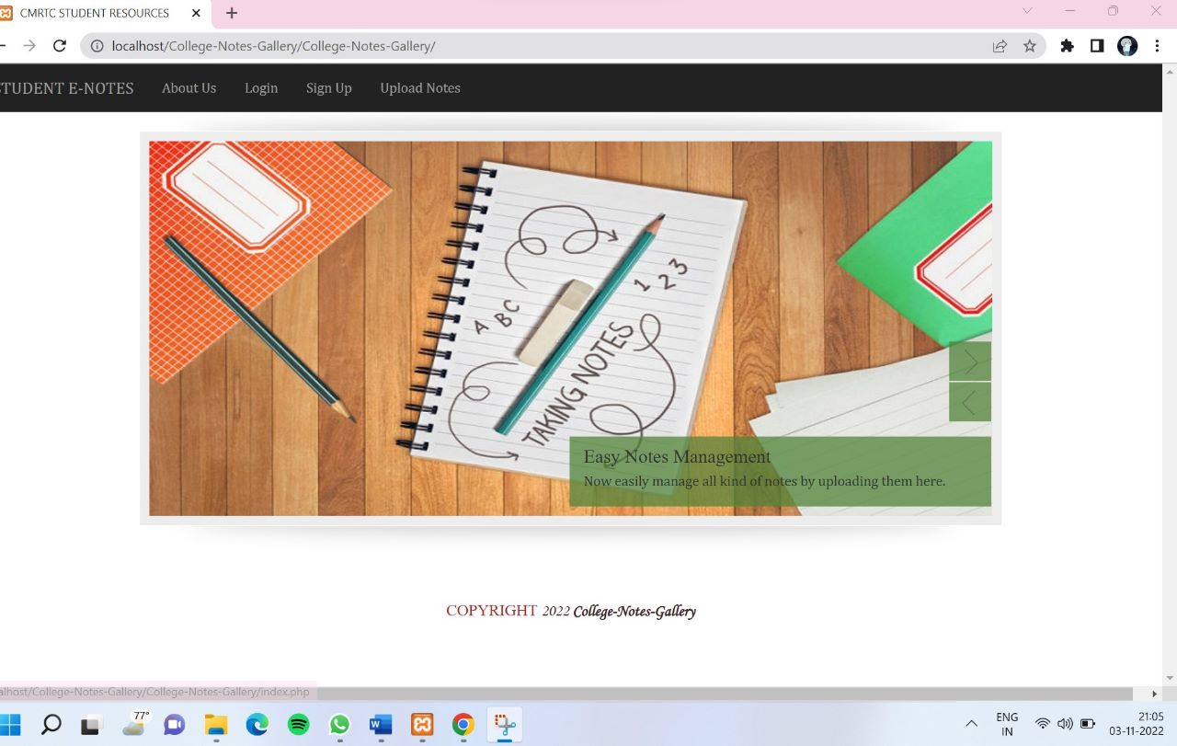
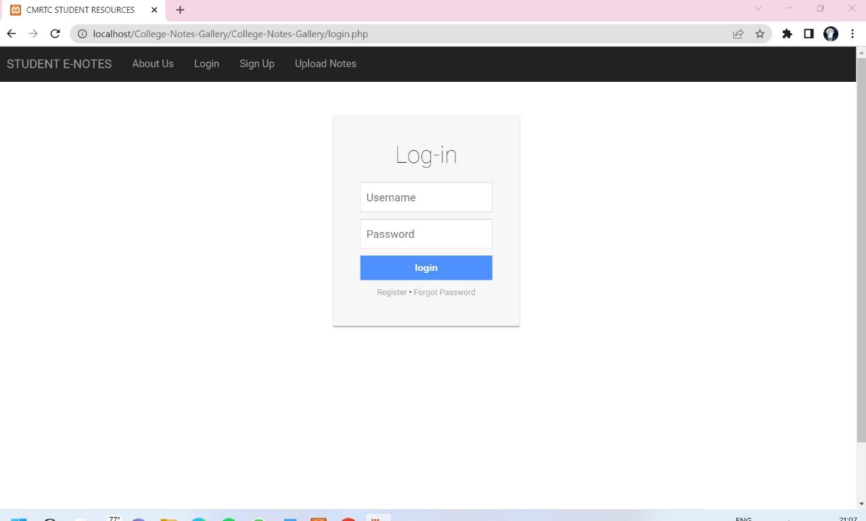
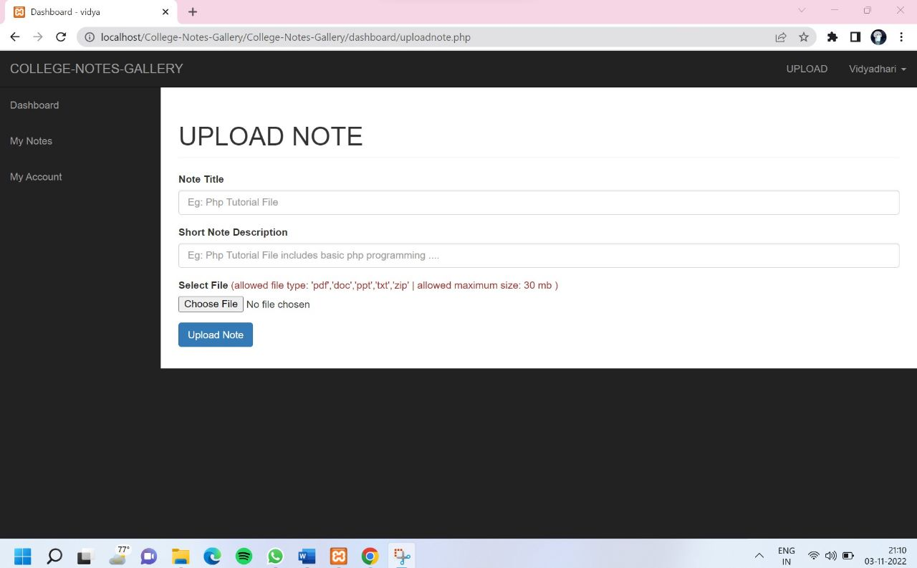
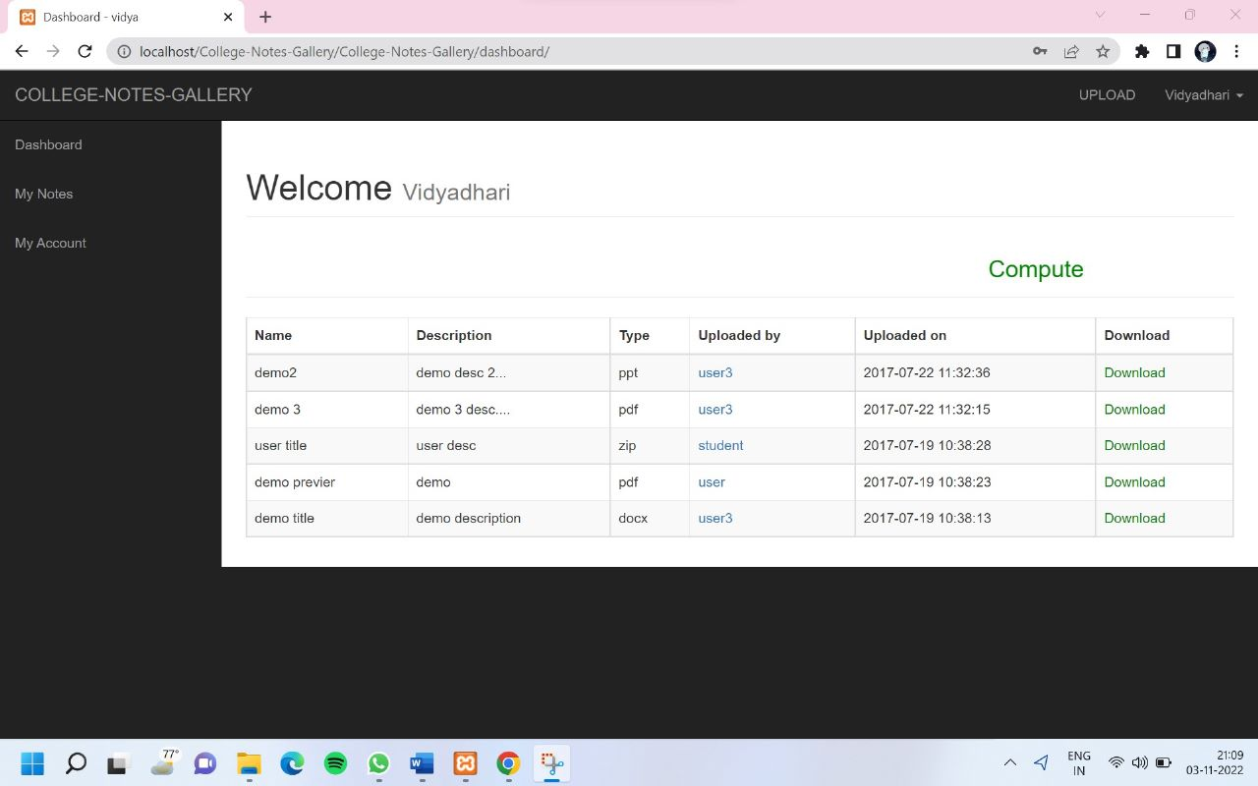
SCREENSHOTS:

Slide 18
CONCLUSION:
This project focuses on the student resources which provides the notes which is explained in class and also provides the previous question paper for reference at time of examination. If student cannot understand the notes they also go through the hyper link which will redirect to lecture videos so they will get the notes in single platform.

Slide 19
THANK YOU

